Slide 1
VCS V5 Programming
Kai Lucas, your best friend

Slide 2
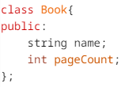
Object Oriented Awesomeness
Programming on the V5 uses Robot C++, not Robot C. C++ is just like C, but it has classes. Skip this slide if you already know what classes are.
Classes are basically custom variables. For example, a book may have a name and a page count. This can be expressed in C++ by the following code:
To make a new Book and set some variables, you could do the following:

Slide 3
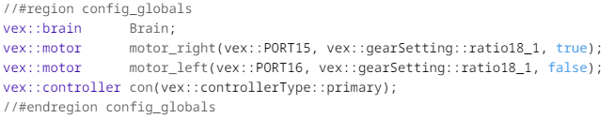
Starting the program
Because devices are controlled through classes, it is much easier and more readable to configure them. In this code snippet, motor_right is an object built off the Motor class, which is plugged into port 15, has a gear ratio of 18 to one, and is reversed.
This code snippet is a basic example on how to spin the motor. It goes forwards, has a velocity of 100, and used percentages as its unit. So it spins at 100 percent.

